Slide 1

Pincho detector CNN
Per: Marc Sirvent (240198),
Marcel Aranich (251453)
Deep Learning 2024

Slide 2
INDEX:
01
02
03
04
05
06
Idea
Architecture
Results
Complications
Improvements
End

Slide 3
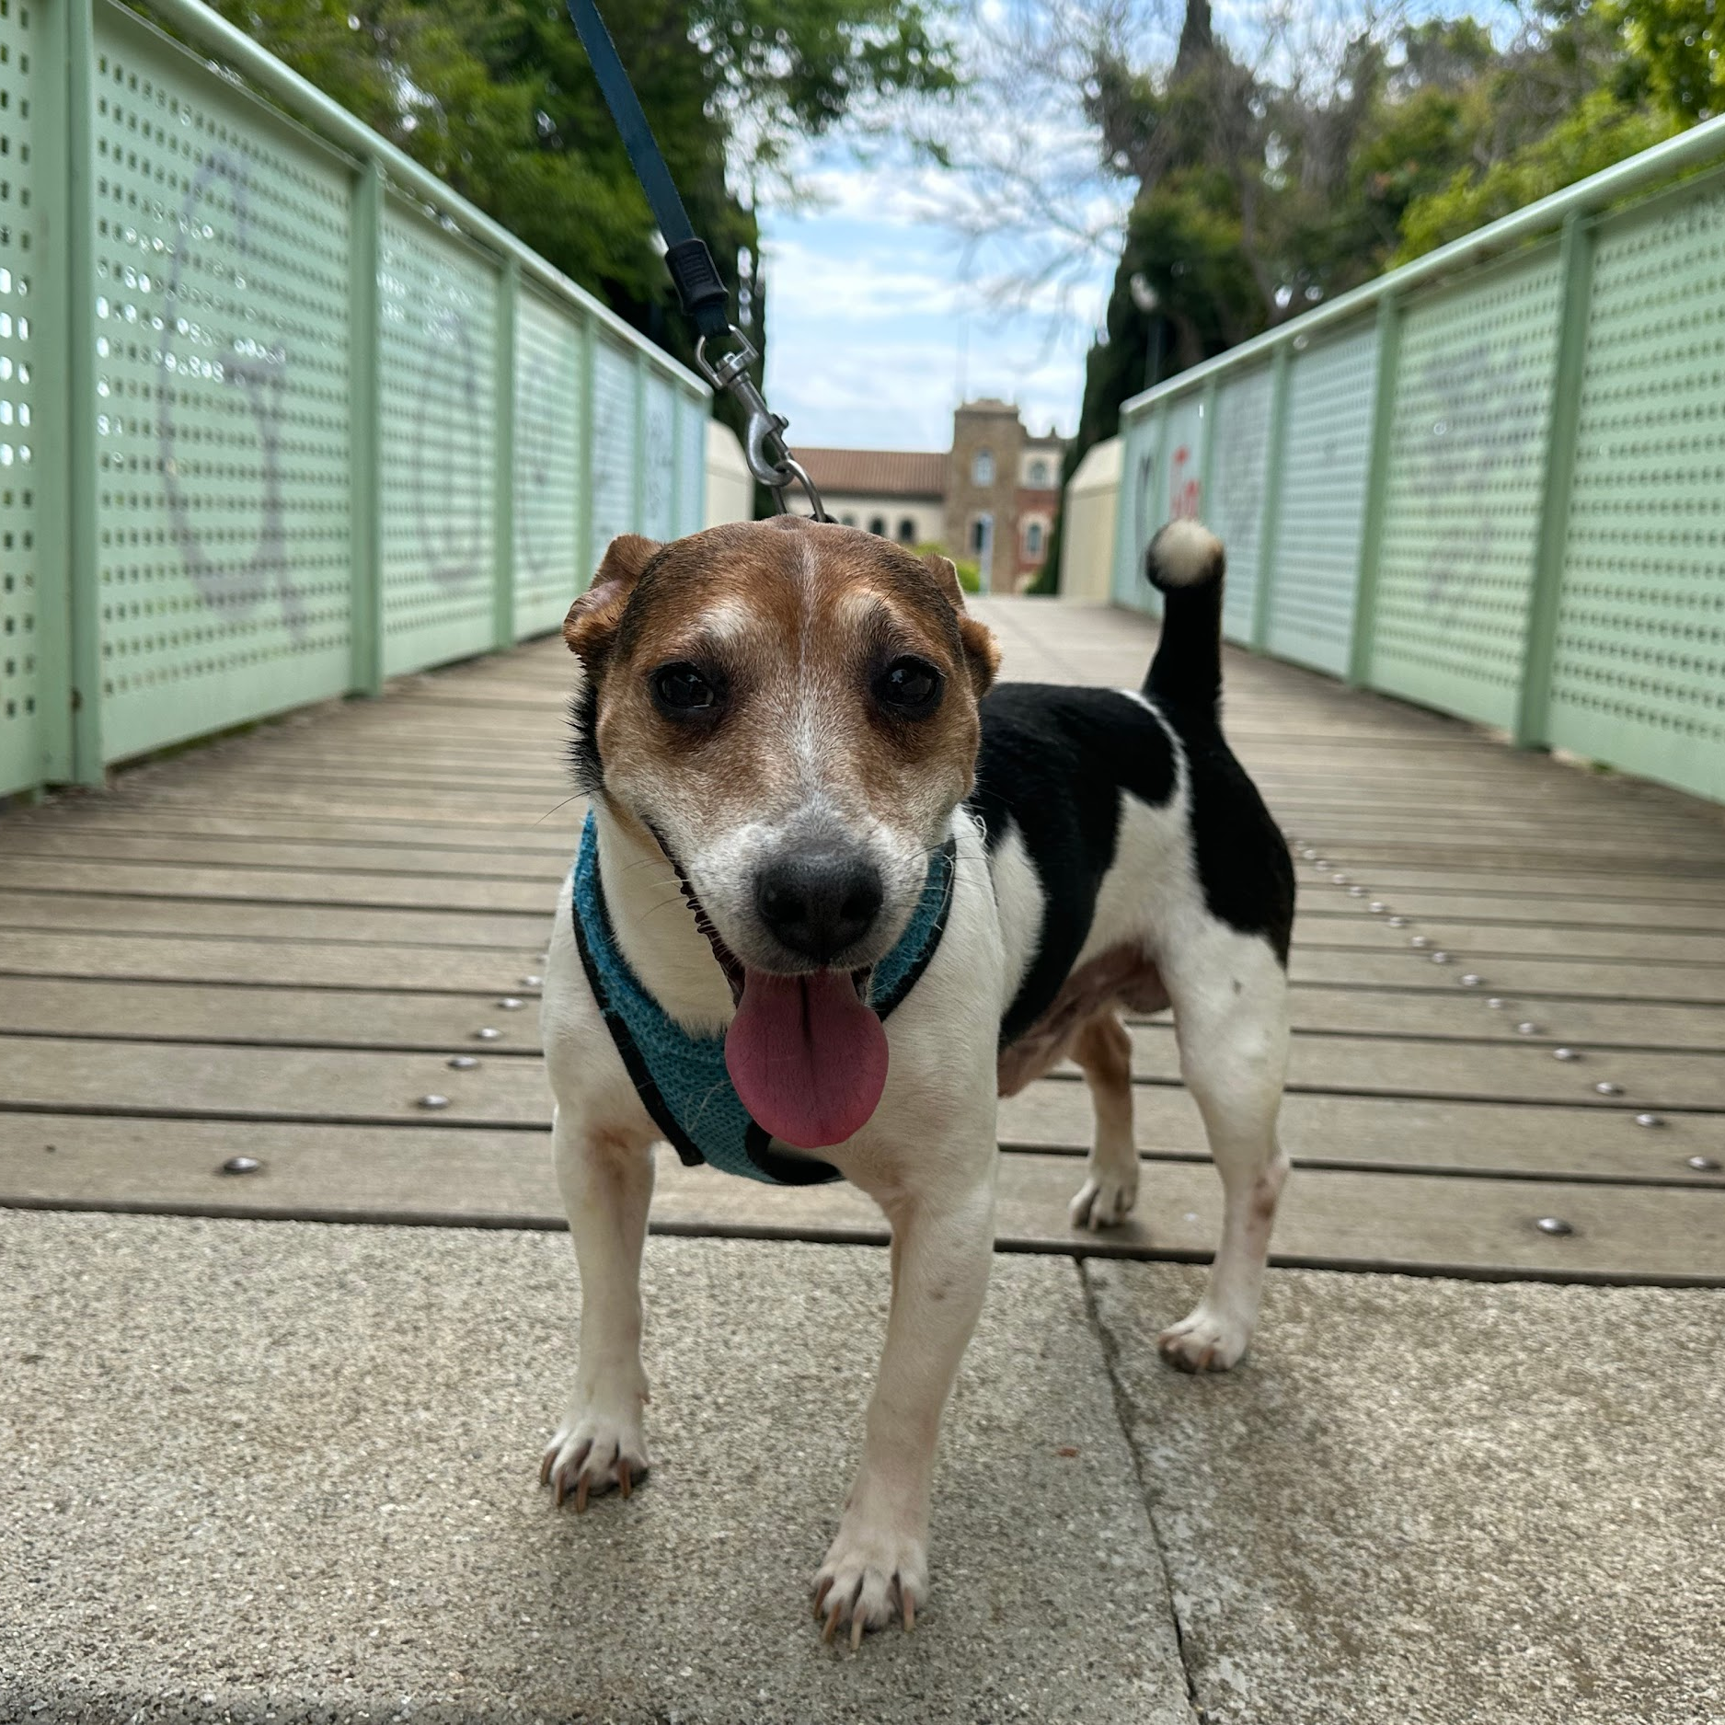
IDEA:
Identify Pincho from any other dog using a convolutional neural network (cnn).

Slide 4
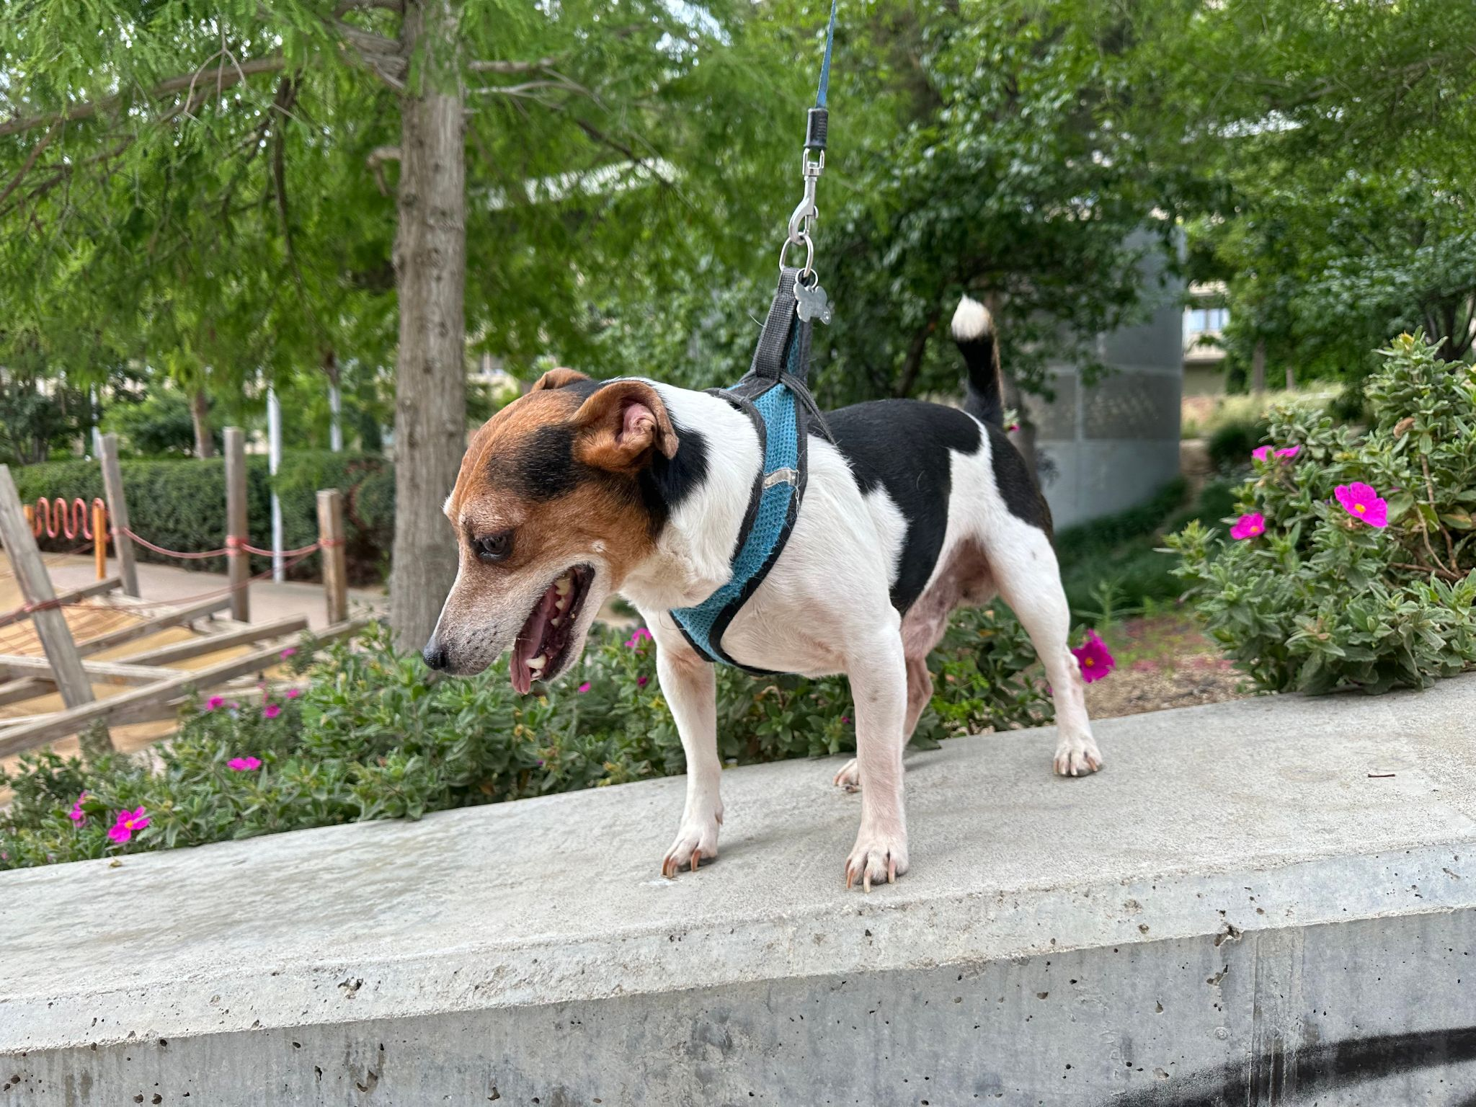
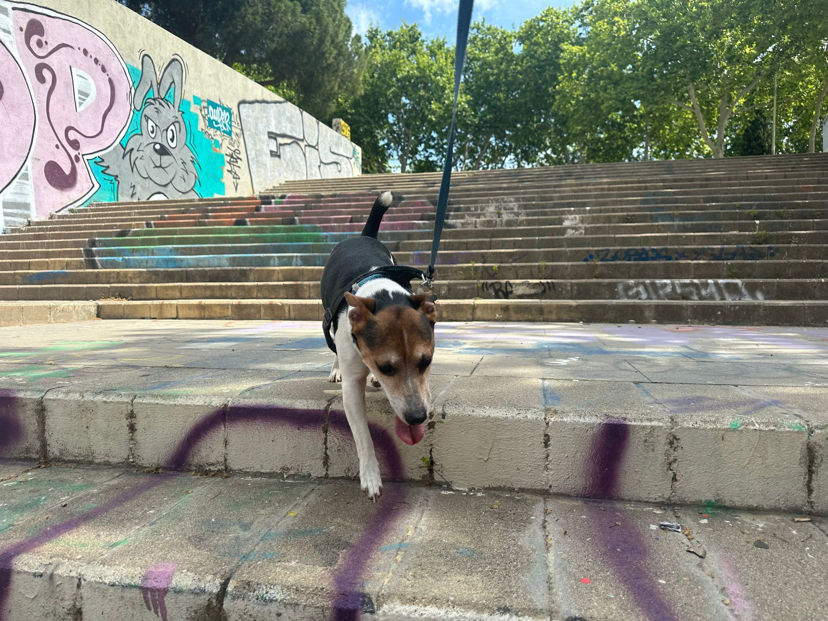
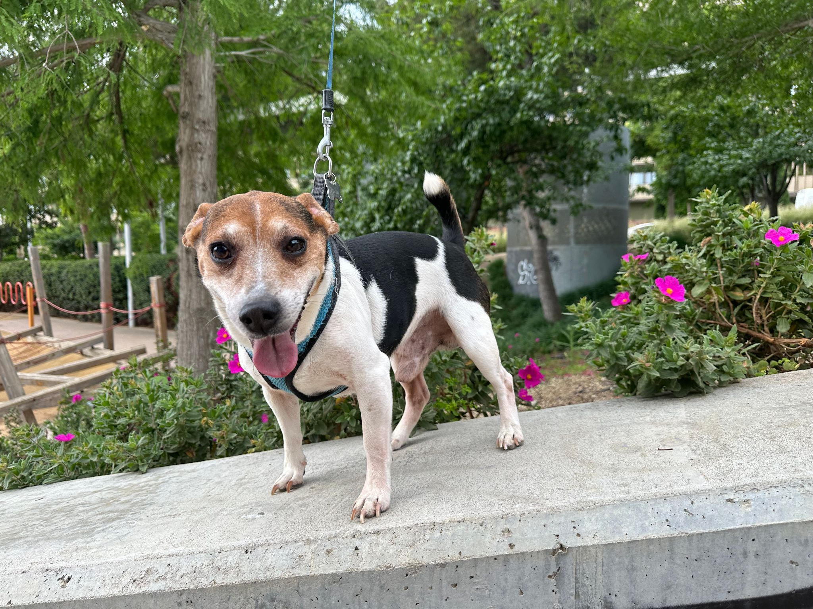
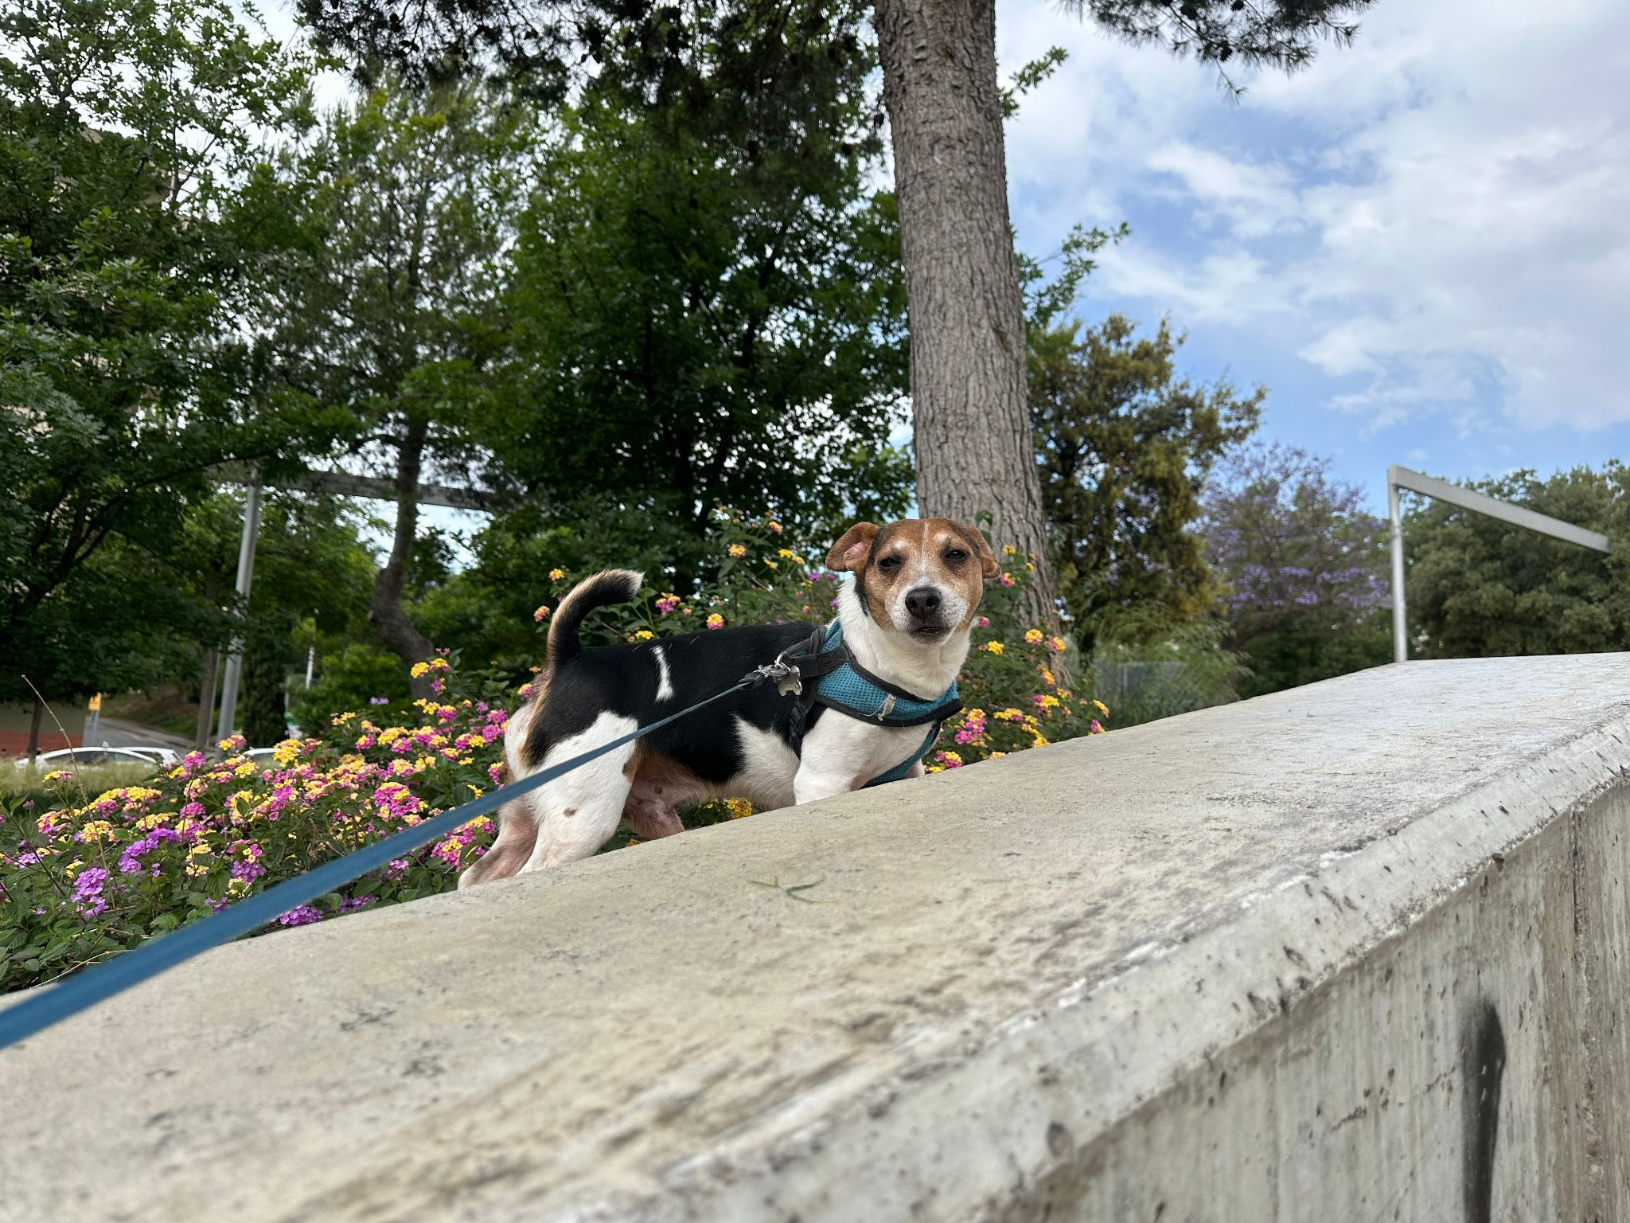
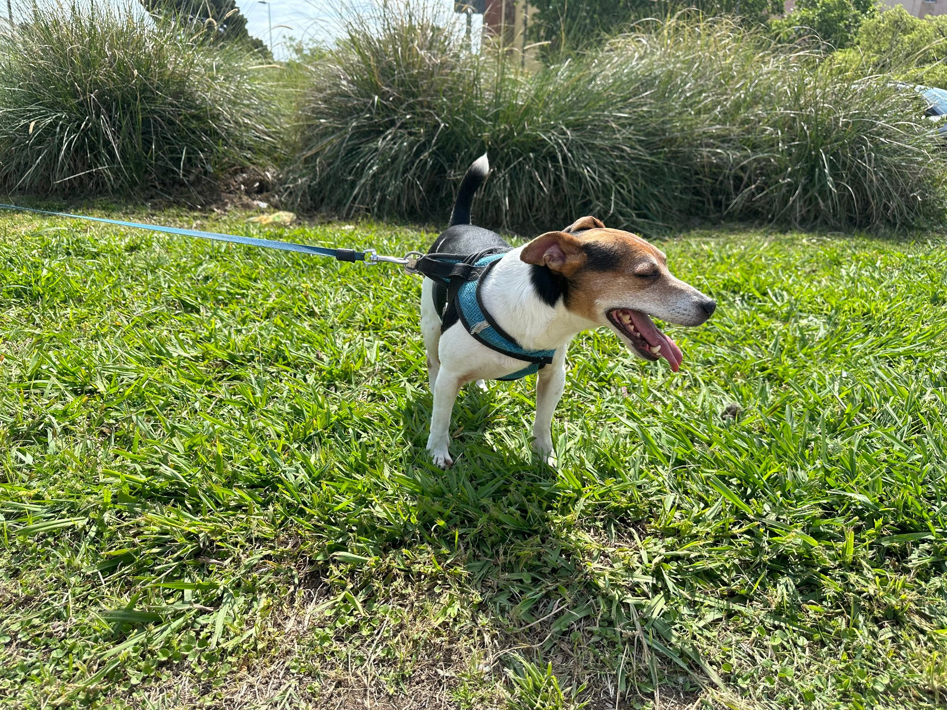
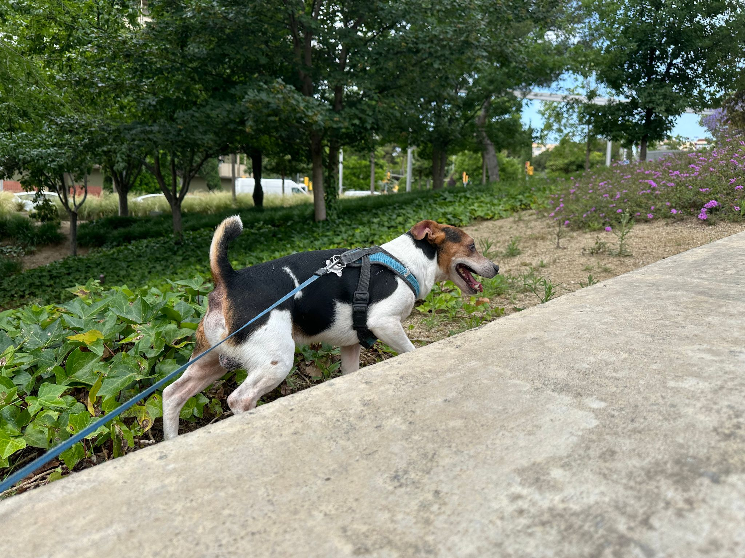
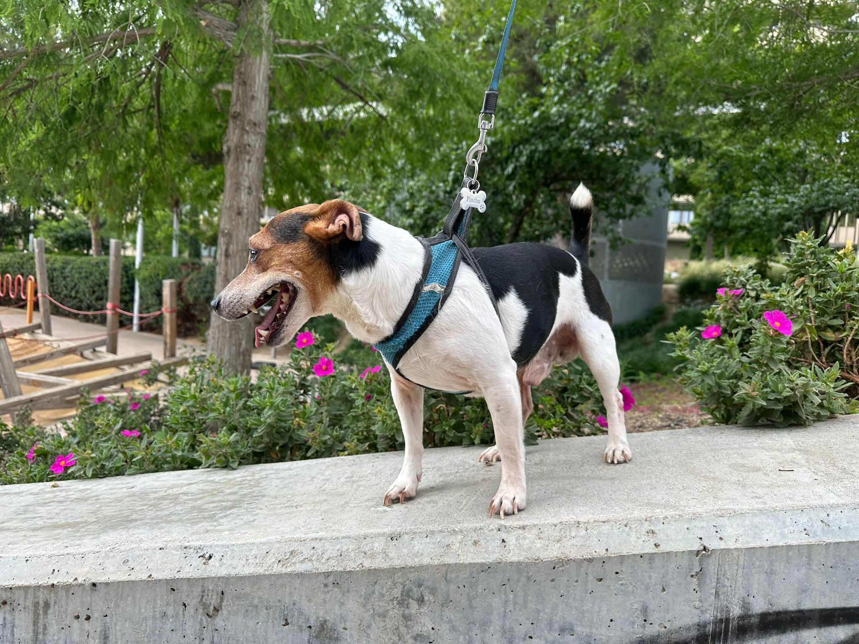
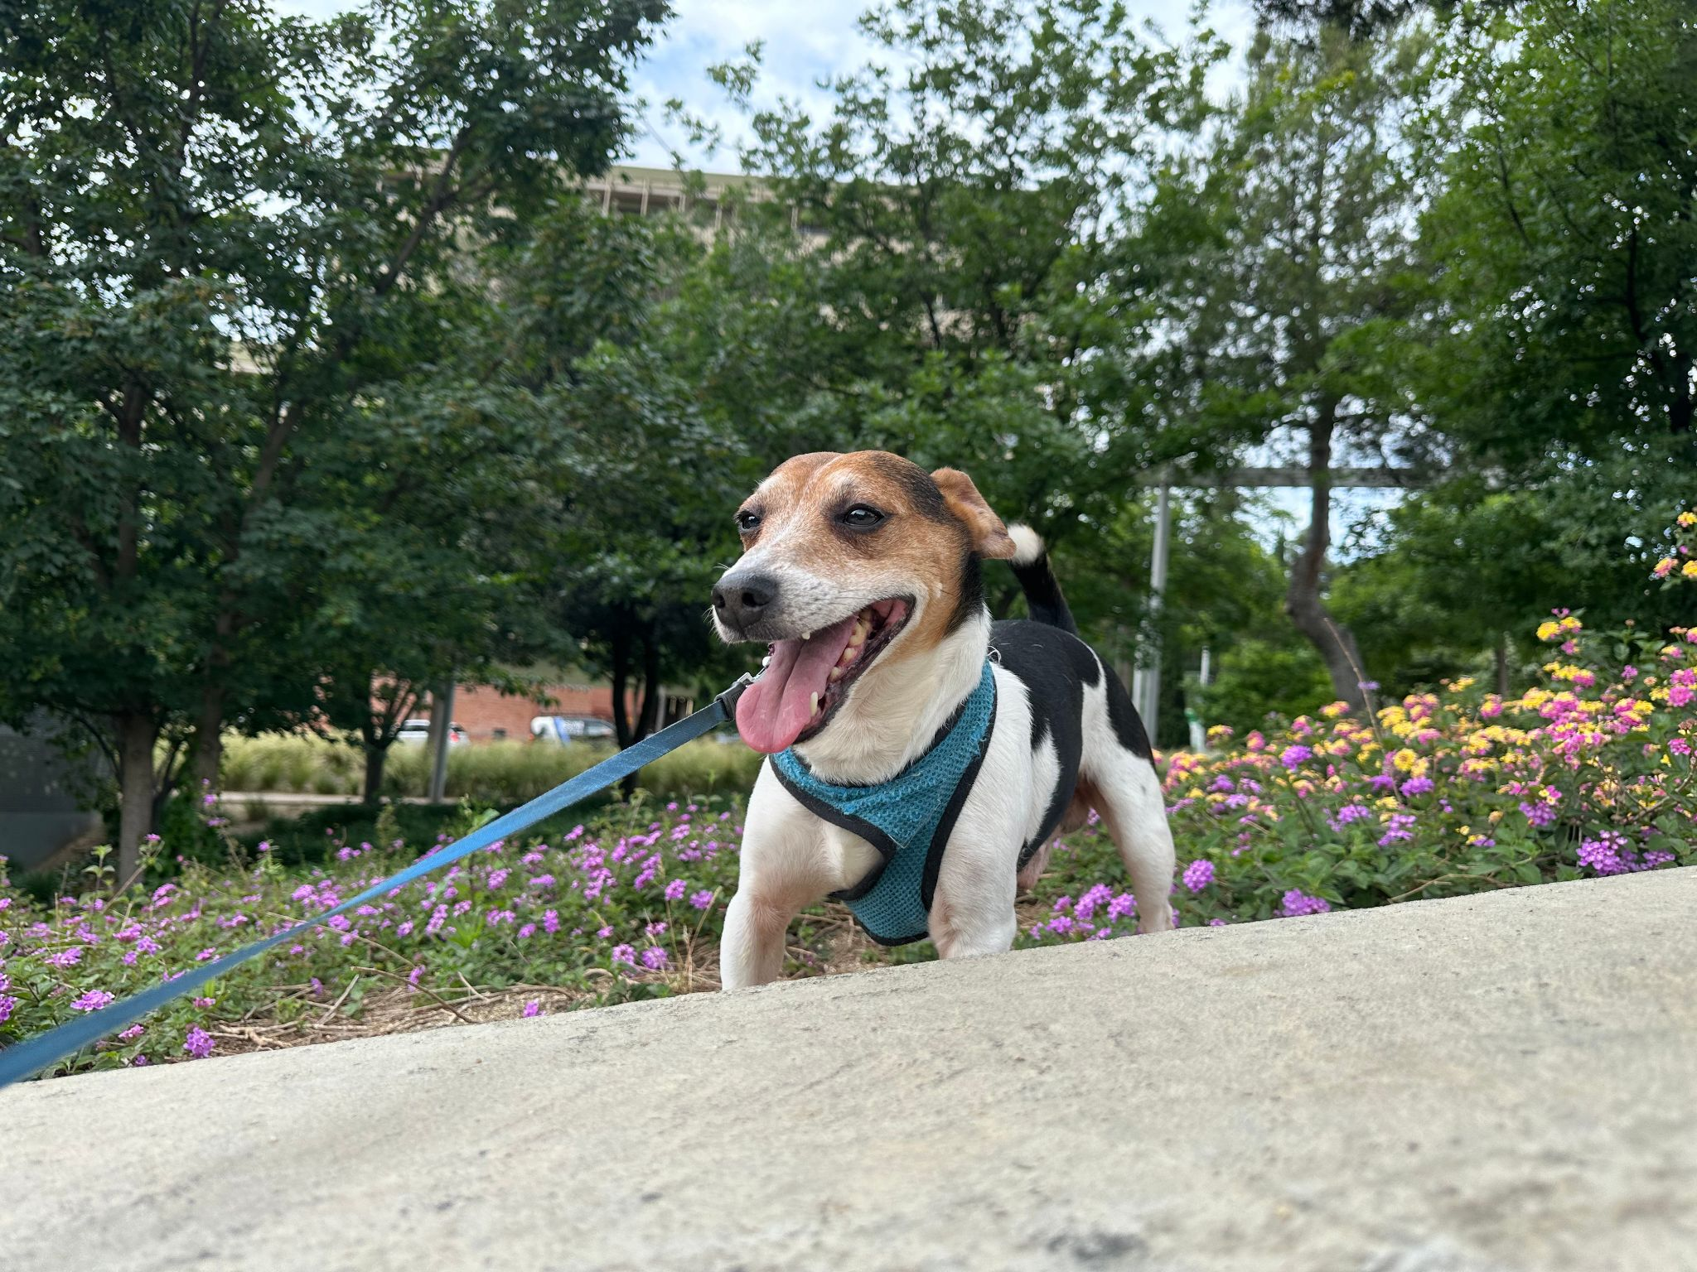
Dataset: Pincho (207)

Slide 5
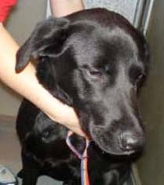
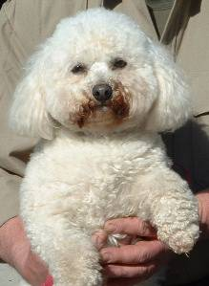
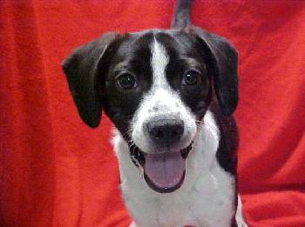
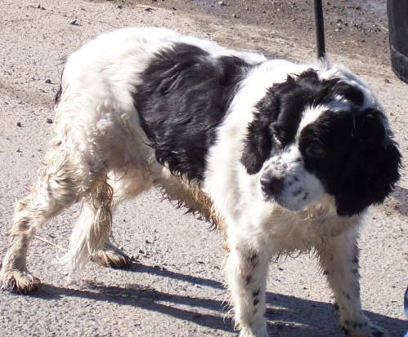
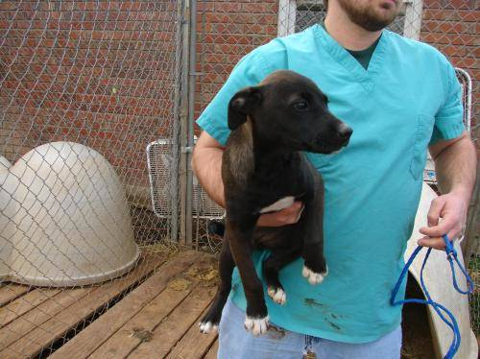
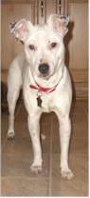
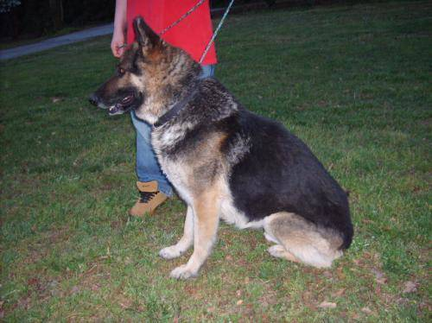
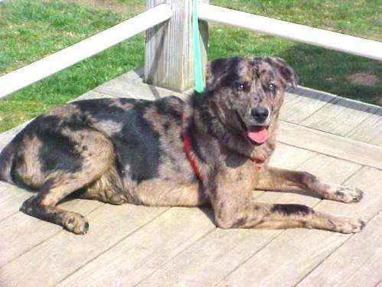
Dataset: Other dogs (4000)
Kaggle: https://www.kaggle.com/datasets/tongpython/cat-and-dog

Slide 6
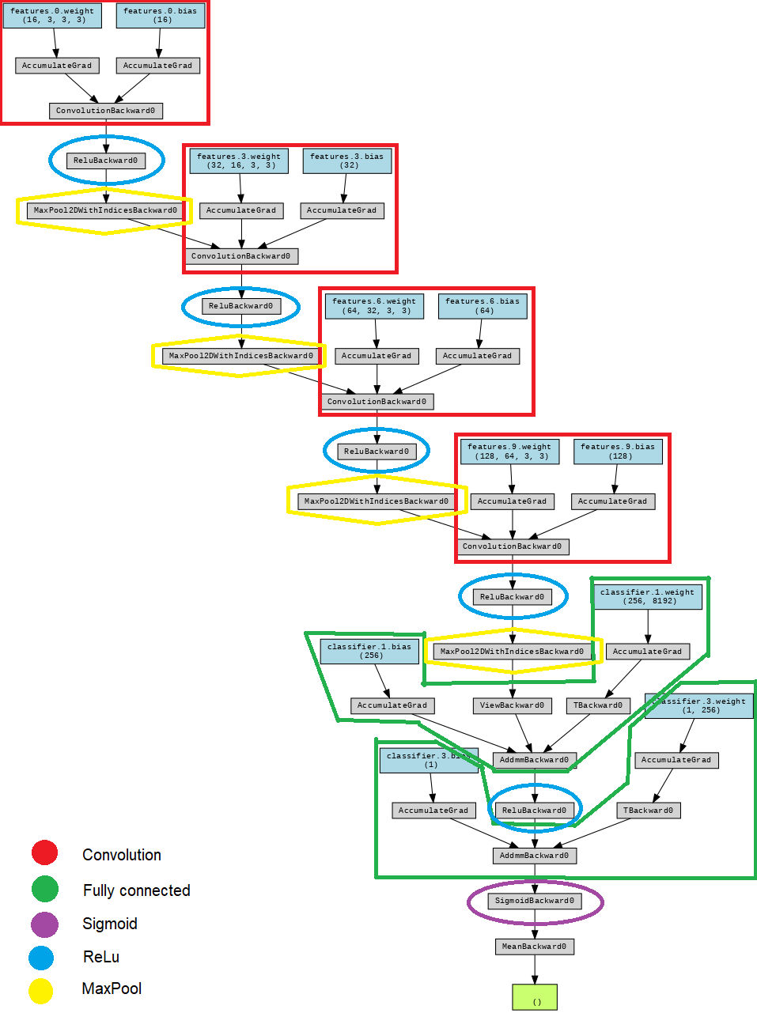
ARCHITECTURE
Convolution
Fully connected
Sigmoid
https://github.com/ashishpatel26/Tools-to-Design-or-Visualize-Architecture-of-Neural-Network
ReLU
MaxPool

Slide 7
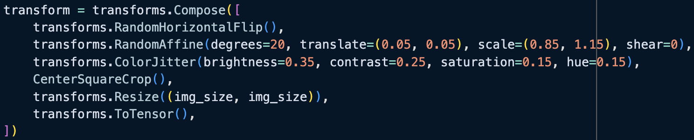
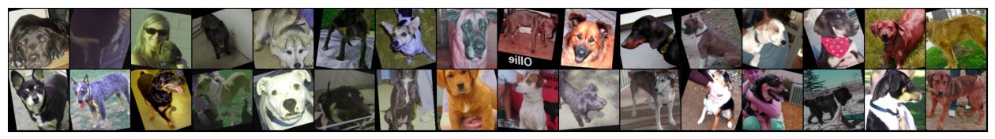
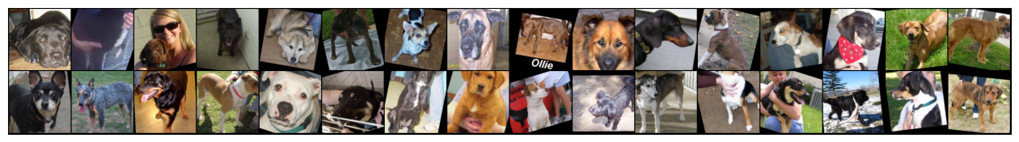
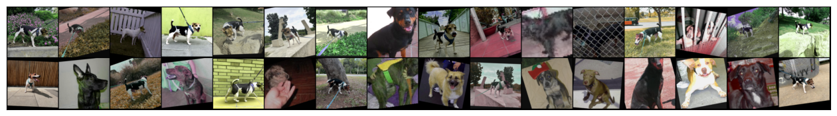
Data augmentation: transformations
#1e1e1eff
transform = transforms.Compose([
transforms.RandomHorizontalFlip(),
transforms.RandomAffine(degrees=20, translate=(0.05, 0.05), scale=(0.85, 1.15), shear=0),
transforms.ColorJitter(brightness=0.35, contrast=0.25, saturation=0.15, hue=0.15),
CenterSquareCrop(),
transforms.Resize((img_size, img_size)),
transforms.ToTensor(),
])

Slide 8
RESULTS:
ACCURACY TRAIN:
ACCURACY TEST:
94.27%
92.68%

Slide 9
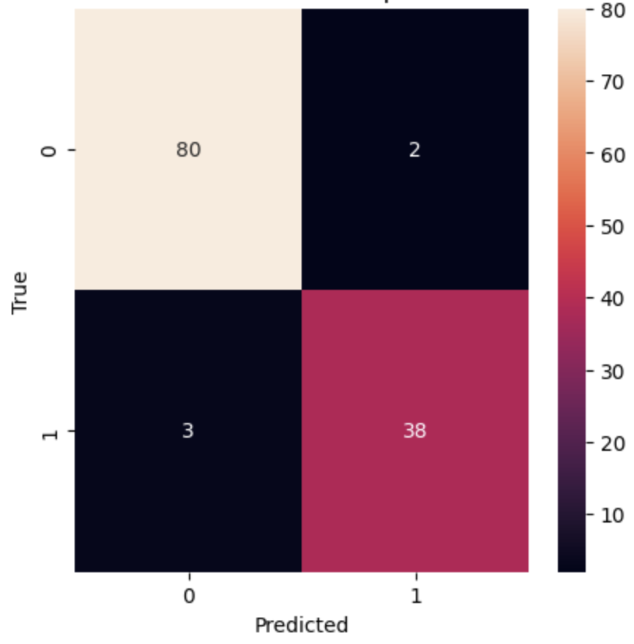
CONFUSION MATRIX:

Slide 10
COMPLICATIONS:
Unbalanced dataset
Choosing hard idea
Non-intelligent results
Original (~13.85 : 1):
4000
204
New (2 : 1):
408
204
Originally tried to do a GAN to generate images of pincho.
Too few images
Poor quality images
Hard to actually do
The model always chose the most probable option instead of actually trying to estimate the correct value.

Slide 11
IMPROVEMENTS:
Targeted data segmentation
Revise architecture
Resize dataset
(Unimplemented) Divide the dataset in phases to make training easier.
More training
Data augmentation

Slide 12
Thanks for your attention!
Any questions?
Per: Marc Sirvent (240198),
Marcel Aranich (251453)
Deep Learning 2024

